Slide 1


High-Intensity, Dynamic Stimuli Complicate
Emotion Regulation Strategy Usage
William Mitchell
Social Affective Neuroscience Lab
Temple University
You can direct questions to: Billy.Mitchell@temple.edu
Notes:
Hi everyone. My name is Billy Mitchell,
I’m a 5th year PhD Candidate in Chelsea Helion’s lab
I’m sorry I can’t be there with you all in person today but I’m going to
present my research using naturalistic approaches to study how we regulate emotion
in high-intensity, dynamic situations.
If you do have any questions throughout, please don’t hesitate to each out to me at my email address
Which you should be seeing in the lower right corner

Slide 2
Notes:
One of the broad motivations for this project was differences in what we can consider [CLICK] theory,
or what we measure in ideal, controlled conditions
[CLICK] and practice, or what we observe in dynamic, complicated daily life.
Most of the time, when we study emotions and emotion regulation,

Slide 3
Theory
Notes:
One of the broad motivations for this project was differences in what we can consider [CLICK] theory,
or what we measure in ideal, controlled conditions
[CLICK] and practice, or what we observe in dynamic, complicated daily life.
Most of the time, when we study emotions and emotion regulation,

Slide 4
Theory
Practice
Notes:
One of the broad motivations for this project was differences in what we can consider [CLICK] theory,
or what we measure in ideal, controlled conditions
[CLICK] and practice, or what we observe in dynamic, complicated daily life.
Most of the time, when we study emotions and emotion regulation …

Slide 5
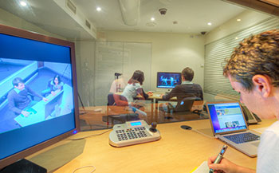
Theory
Practice
Notes:
… we’re doing so in relatively ideal conditions and usually in controlled isolated lab environments.

Slide 6
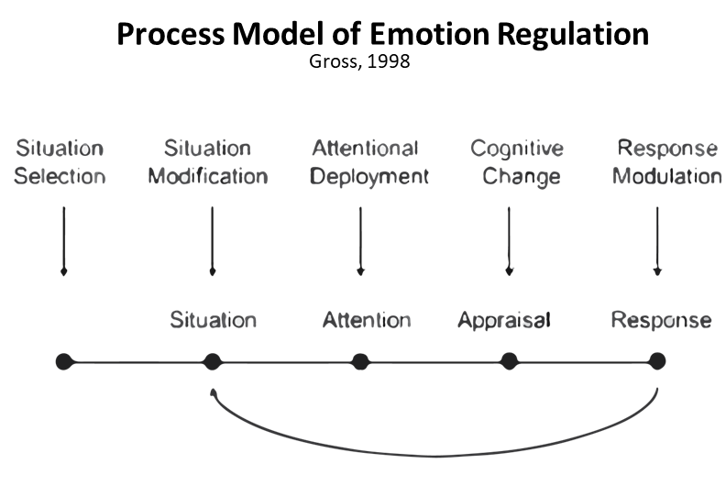
Theory
Practice
Notes:
For example, you may be familiar with Gross’s Process Model.
It posits that self-regulation can be categorized into different strategies based upon when self-regulation is applied in the time course of an event.
These five strategies have different strengths, weaknesses, and costs as a result.
We often test this Process Model theory via stimulus-response paradigms …

Slide 7
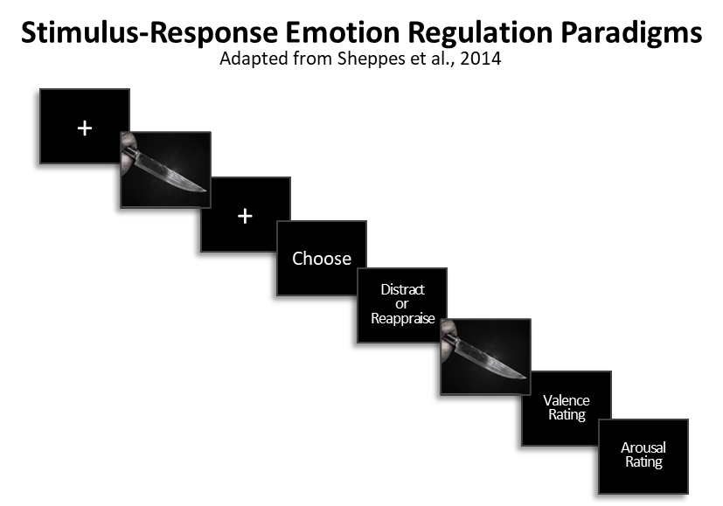
Notes:
…during which participants are first trained in different strategies and then shown a preview of an emotionally-evocative often negative, often unimodal stimulus.
Subjects receive a prompt to regulate their emotions and then must choose one or two strategy options.
we then regulate their emotions, and report the effects of that self-regulation.

Slide 8
As emotional intensity increases, the probability of choosing Distraction instead of Reappraisal increases (Sheppes et al., 2011)
Meta-analysis suggests this effect size is “very large”; r+ = 0.46 – 0.61 (Matthews et al., 2021)
Notes:
Through these paradigms, we’ve learned about the strengths of these strategies and the situations in which they best fit.
For example, there is a robust relationship between how intense an emotional experience is and which strategies we choose to regulate those emotions with.

Slide 9
As emotional intensity increases, the probability of choosing Distraction instead of Reappraisal increases (Sheppes et al., 2011)
Meta-analysis suggests this effect size is “very large”; r+ = 0.46 – 0.61 (Matthews et al., 2021)
Additionally, Distraction is more effective at reducing high-intensity negative emotion than Reappraisal (Shafir et al., 2016)
Notes:
Distraction is not only chosen more often when emotional intensity is high,
but also tends to be more effective at reducing or downregulating high-intensity negative emotions than reappraisal is.
This suggests, for example, that if you’re feeling very bad at the loss of loved one, focusing your attention on something else might be better at reducing those negative feelings
than trying to change the meaning of or how you interpret the loss.

Slide 10
As emotional intensity increases, the probability of choosing Distraction instead of Reappraisal increases (Sheppes et al., 2011)
Meta-analysis suggests this effect size is “very large”; r+ = 0.46 – 0.61 (Matthews et al., 2021)
Additionally, Distraction is more effective at reducing high-intensity negative emotion than Reappraisal (Shafir et al., 2016)
Failed self-regulation can have rebound effects, leaving you worse than if you hadn’t tried to self-regulate (Yeh et al., 2020)
Notes:
These strategy strengths matter because failed self-regulation not only means you didn’t meet your goal,
but it can also have rebound effects, leaving you feeling worse than you had in the first place.
If the emotion that we are trying regulate is simply mild disappointment that the subway is running late …

Slide 11

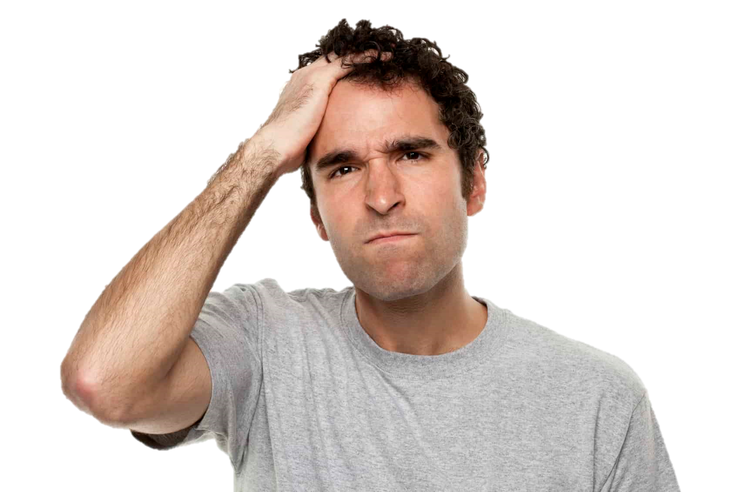
As emotional intensity increases, the probability of choosing Distraction instead of Reappraisal increases (Sheppes et al., 2011)
Meta-analysis suggests this effect size is “very large”; r+ = 0.46 – 0.61 (Matthews et al., 2021)
Additionally, Distraction is more effective at reducing high-intensity negative emotion than Reappraisal (Shafir et al., 2016)
Failed self-regulation can have rebound effects, leaving you worse than if you hadn’t tried to self-regulate (Yeh et al., 2020)
Notes:
… it might not matter very much if we fail to regulate in the long run …

Slide 12

Theory
Practice
As emotional intensity increases, the probability of choosing Distraction instead of Reappraisal increases (Sheppes et al., 2011)
Meta-analysis suggests this effect size is “very large”; r+ = 0.46 – 0.61 (Matthews et al., 2021)
Additionally, Distraction is more effective at reducing high-intensity negative emotion than Reappraisal (Shafir et al., 2016)
Failed self-regulation can have rebound effects, leaving you worse than if you hadn’t tried to self-regulate (Yeh et al., 2020)
Notes:
… but how we keep our cool can be much more important in highly stressful, very intense situations; perhaps if we feel threatened or unsafe.
But there’s a gap in the research here.

Slide 13

Notes:
The stimulus response paradigm prioritizes internal validity,
so the extent to which those relationships translate to more complicated life events is unclear.

Slide 14

High-Stress Events in our lives can be:
Intense
Notes:
For one, the events in our lives when self-regulation can really matter can be intense and aversive to a degree that stimulus response paradigms often fall short of.

Slide 15

High-Stress Events in our lives can be:
Intense
Unexpected
Notes:
Events in our lives can also be unpredictable, making it difficult to prepare an appropriate response.
We don’t often get training or explicitly prompted to self-regulate.

Slide 16

High-Stress Events in our lives can be:
Intense
Unexpected
Dynamic
Notes:
The events we care about also unfold over longer time courses than we often can allow within our studies

Slide 17

High-Stress Events in our lives can be:
Intense
Unexpected
Dynamic
Complex
Notes:
And lastly, events and our response to those events can be really complex.
Events can be compounded. Sensations may be multimodal.
Binary choices may not adequately represent natural self-regulation tendencies.

Slide 18
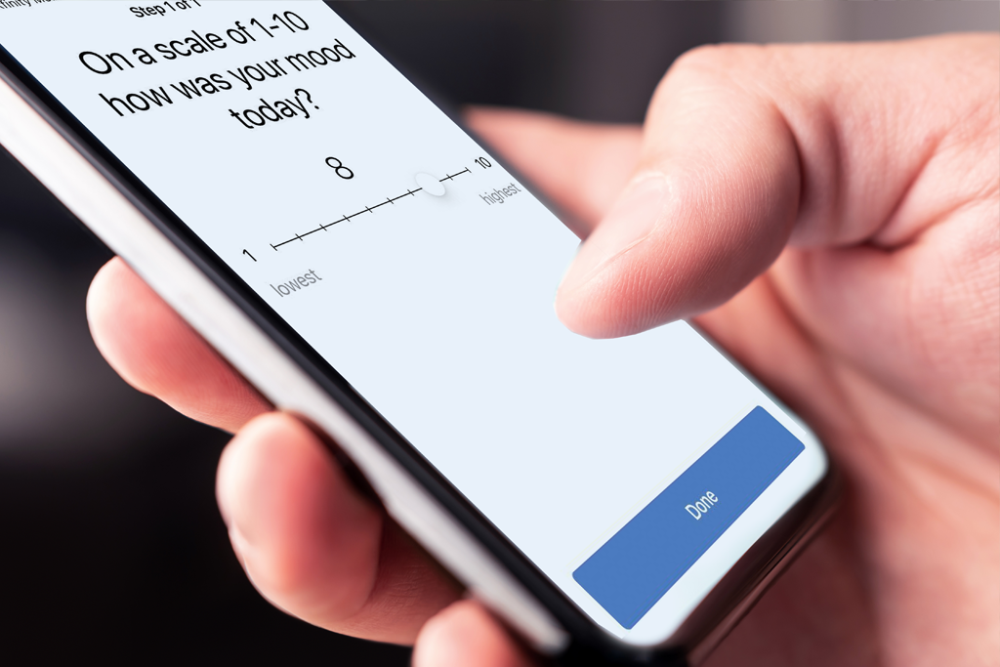
High-Stress Events in our lives can be:
Intense
Unexpected
Dynamic
Complex
Notes:
Ecological momentary assessment approaches address some of these concerns,
but many still train participants in self-regulation, encourage subjects to focus on emotion regulation,
and often have difficulty consistently capturing emotion regulation during these high-stress events.

Slide 19
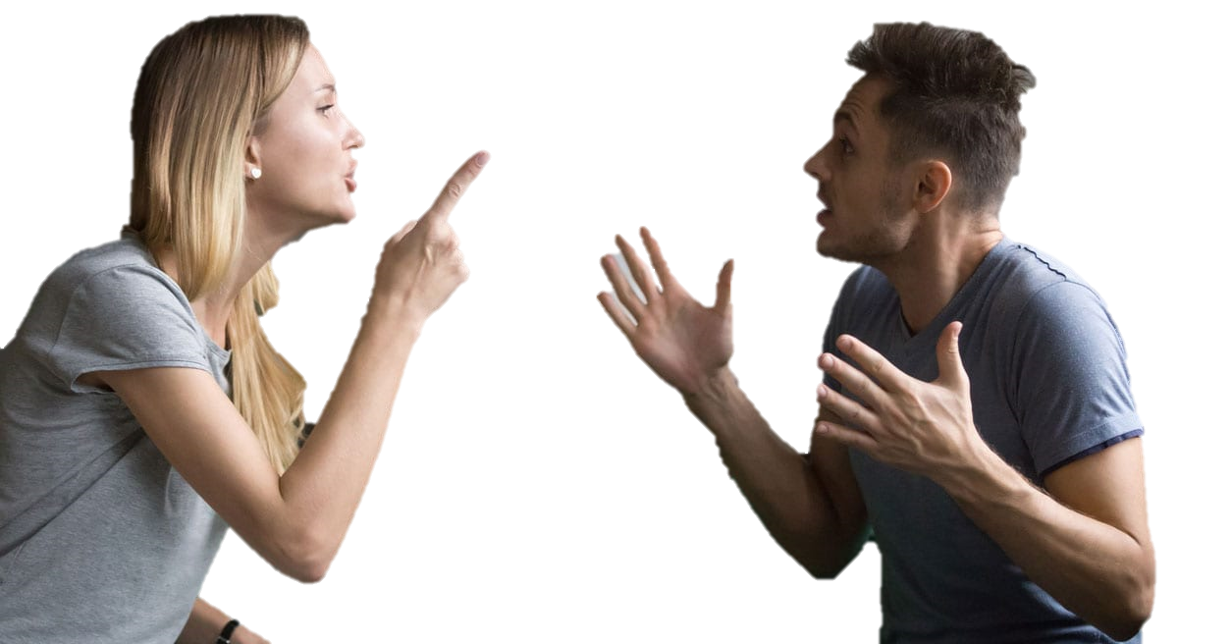
Regulation
Choice
Regulation
Usage
Notes:
And so what we wanted to do with this project
was examine self-regulation usage when subjects aren’t trained,
when they aren’t constrained to two strategies,
when researchers don’t prompt them to regulate,
and when they’re in less controlled but more stressful conditions than what had been done in the past.

Slide 20
Will emotional intensity predict the probability of choosing Distraction and Reappraisal when events are intense, unexpected, dynamic, and complex?
Notes:
Given the strength of the relationship between intensity and regulation strategy choice in controlled settings,
our working hypothesis was that affective intensity should positively predict the use of distraction over reappraisal.
However, that’s not quite what we found.

Slide 21
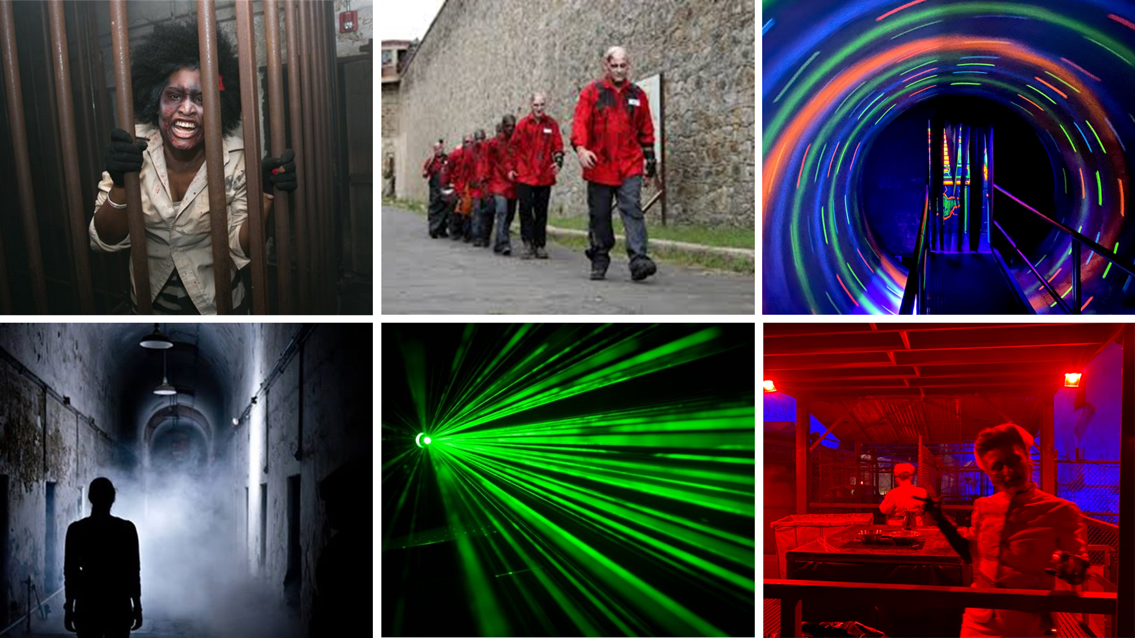
Other Recent H.H. Studies:
Clasen et al., 2019
Tashjian et al., 2022
Notes:
We initially tested this hypothesis by running two experiments at a highly-regarded haunted house in Philadelphia called Eastern State Penitentiary.
Haunted house experiences have been recently used by other researchers for similarly affective questions because they possess many of those previously mentioned features.

Slide 22
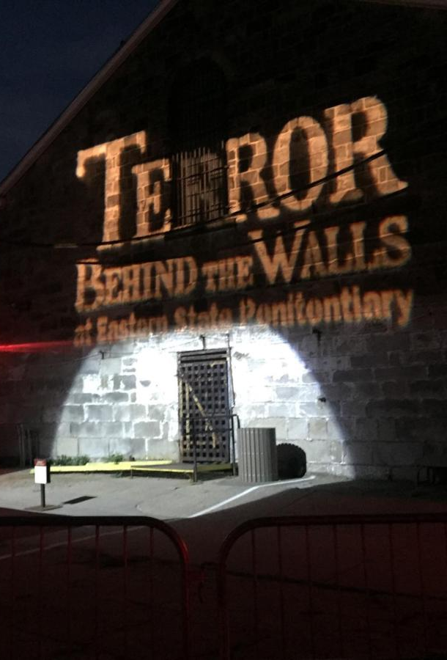
What can TBTW offer?
Feature-rich but relatively controlled environment
Notes:
They can also feel dangerous and chaotic while still being safe and controlled.

Slide 23
What can TBTW offer?
Feature-rich but relatively controlled environment
Limited researcher intervention
Notes:
Participants can have a relatively naturalistic experience with limited researcher intervention or direction

Slide 24
What can TBTW offer?
Feature-rich but relatively controlled environment
Limited researcher intervention
Performances are reliably consistent
Notes:
Participants witness very consistent performances from highly trained actors, and our haunted house gave us special access to guarantee this for our study.

Slide 25
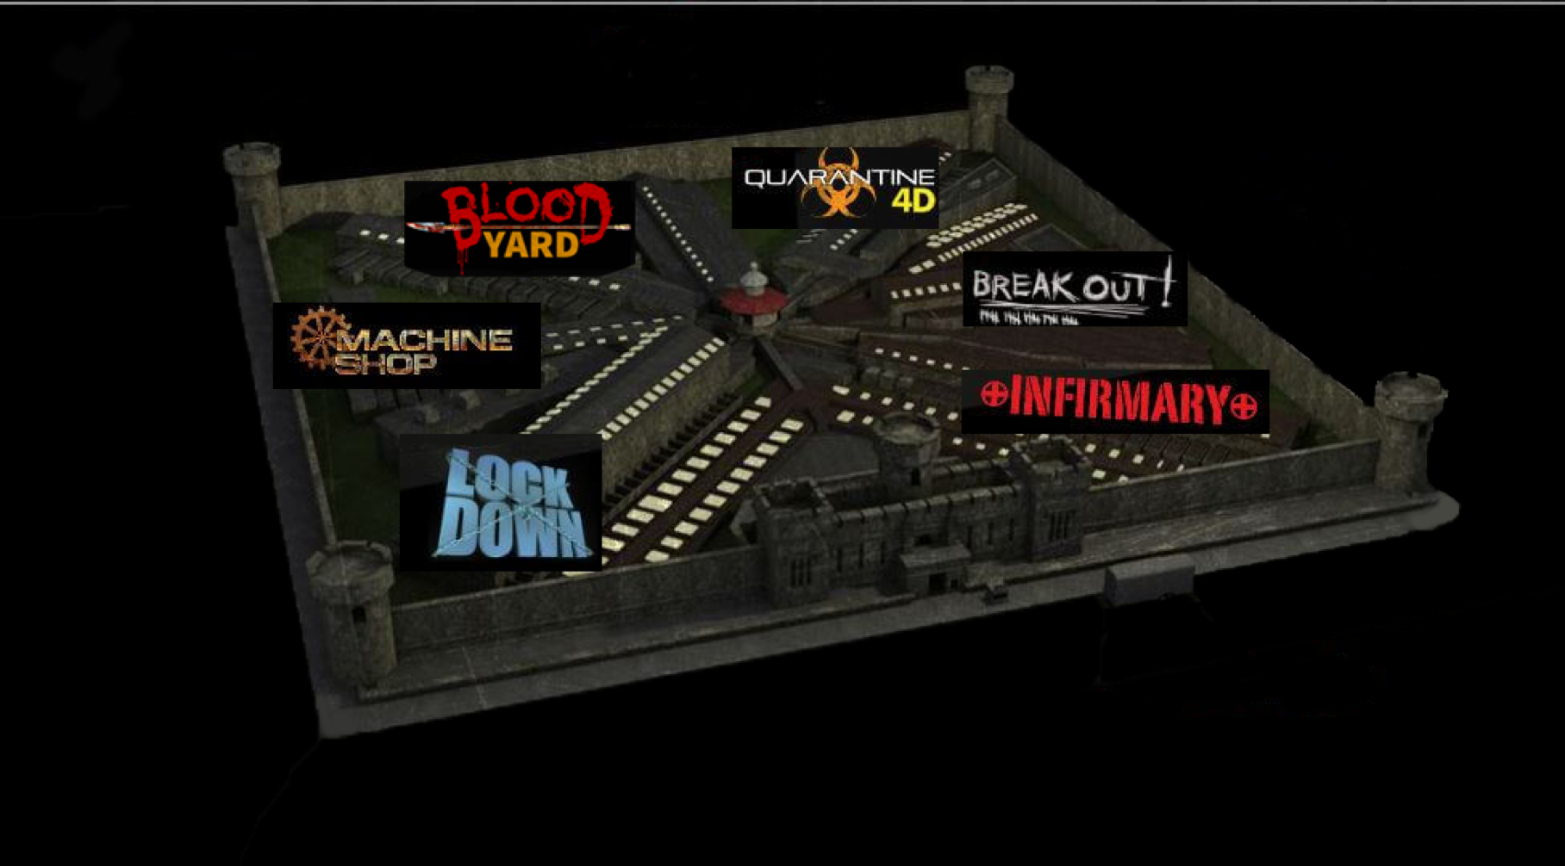
What can TBTW offer?
Feature-rich but relatively controlled environment
Limited researcher intervention
Performances are reliably consistent
Great stimuli variability
Notes:
Lastly, the themed sections offered a wide variety of stimuli to elicit varied emotions.
Despite these strengths, a common concern is that haunted houses are often designed to be entertainment, so subjects might be experiencing amusement and not regulating.

Slide 26
When feeling intense emotions, people self-regulated
People who do not enjoy haunted houses regulate more events within the haunted house. r² adj. = 0.242
Notes:
However, we found that self-reported Haunted house enjoyment negatively predicted with how frequently subjects regulated their emotions …

Slide 27
When feeling intense emotions, people self-regulated
People who do not enjoy haunted houses regulate more events within the haunted house. r² adj. = 0.242
As startle sensitivity increases, the number of regulated events within the haunted house increases. r² adj. = 0.085
Notes:
… and that individuals who were more easily startled reported self-regulating more frequently while in the haunted house, too.
So subjects who we might expect to need to self-regulate in this setting were self-regulating as expected without any prompts to do so.

Slide 28
When feeling intense emotions, people self-regulated
People who do not enjoy haunted houses regulate more events within the haunted house. r² adj. = 0.242
As startle sensitivity increases, the number of regulated events within the haunted house increases. r² adj. = 0.085
As anxiety increased within the haunted house, so did participants’ self-reported efforts to emotionally regulate. r² adj. = 0.095
Notes:
Additionally, as state anxiety increased subjects reported putting more effort towards trying to self-regulate …

Slide 29
When feeling intense emotions, people self-regulated
People who do not enjoy haunted houses regulate more events within the haunted house. r² adj. = 0.242
As startle sensitivity increases, the number of regulated events within the haunted house increases. r² adj. = 0.085
As anxiety increased within the haunted house, so did participants’ self-reported efforts to emotionally regulate. r² adj. = 0.095
As negative affective intensity increased for a given event, people put more effort towards regulating their emotions during that event.
Notes:
… and participants also increased their regulation efforts as the affective intensity that they reported increased as well.
And so all of these findings together did seem to suggest that self-regulation is following some predictable patterns in this setting.

Slide 30
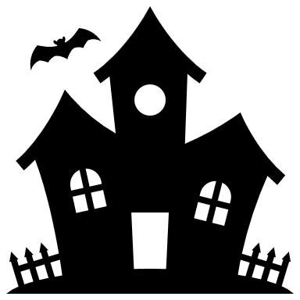
COMMON METHODS ACROSS STUDIES
Subjects instructed to experience haunted house naturally
Subjects received no emotion regulation training
Subjects self-identified most emotionally-salient events
Recorded affective intensity, regulation effort and described strategy in their own words for each event
Strategy descriptions were coded and categorized by hypothesis blind independent raters
Study 1
(N = 58)
Conducted in 2019
One week lag in data collection
Ten (10) events were captured
Emotions sourced from PANAS
Strategy IRR = 0.881
Study 2
(N = 118)
Conducted in 2021
No lag in data collection
Three (3) events were captured
Emotions were free response
Strategy IRR = 0.877
Notes:
To setup the experiments, subjects traversed the 45 minute haunted house experience in small groups accompanied by a research assistant.
Subjects were instructed to not touch one another, to stay in a single file line, to not discuss their experience until after reporting
but to otherwise experience the haunted house as they naturally would.
They were not told that this was an emotion regulation study and were not trained to use any strategies.
Instead, after completing the haunted house, each participant self-identified events from within the haunted house that were most emotionally salient to them.
They then reported which emotions they felt, how intense those emotions were, and how they attempted to self-regulate, if at all, in their own words.
The regulation descriptions were reviewed by hypothesis blind independent raters trained using landmark literature from the emotion regulation field.
Events could be classified as containing reappraisal, distraction, both strategies, or neither and both sets of raters demonstrated strong agreement in their classifications.
There were a few minor differences between study 1 and 2, which are noted here.

Slide 31
We are certainly self-regulating, but how we do so is complicated ...
Mitchell et al., (Under Review)
Notes:
From here the analyses were relatively simple.
Using multi-level binary logistic regression, we examined the association between reported emotion intensity and strategy usage during every event in which either reappraisal or distraction was described.
So on our X axis, we have the self-reported emotional intensity of the event, which was captured on a 5-point likert scale.
And on our Y axis we have the probability that that event was regulated via distraction, with 1 representing a definitive use of distraction and 0 representing a definitive use of reappraisal.

Slide 32
We are certainly self-regulating, but how we do so is complicated ...
Affective intensity did not predict which strategy participants used when regulating their emotions in this context.
Mitchell et al., (Under Review)
Notes:
Both studies failed to yield any significant association between intensity and strategy usage.
Visualized here, we can see the results for Study 2, which mirrors study 1 pretty closely.

Slide 33
We are certainly self-regulating, but how we do so is complicated ...
Affective intensity did not predict which strategy participants used when regulating their emotions in this context.
This was true even when taking a multiverse approach and adjusting for known covariates including cognitive load, sex, and ERQ scores.
Mitchell et al., (Under Review)
Notes:
This was true even when adjusting for covariates including cognitive load, sex, and biases in choosing regulation strategies.
To try to be as generous as possible to the established hypothesis, we also took a multiverse approach…

Slide 34
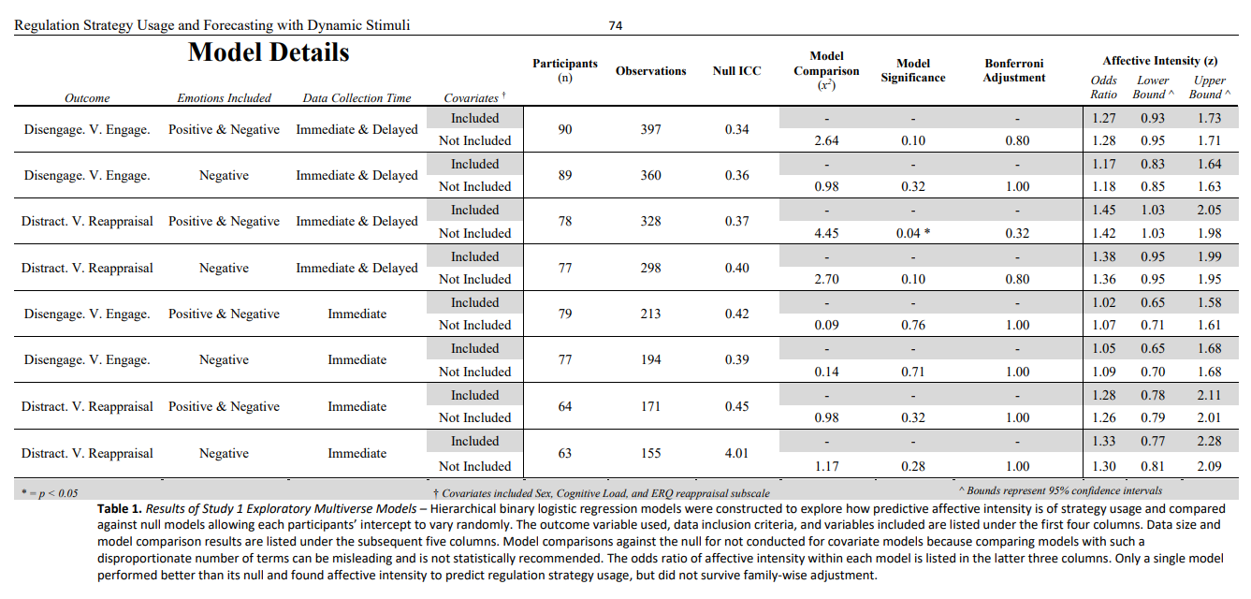
Notes:
…running the analysis multiple times while changing the inclusion criteria.
This included including and excluding observations featuring positive and negative emotions, strategies beyond distraction and reappraisal, and the time at which the data was collected.
None of these changes produced a model in which intensity significantly predicted strategy usage after adjusting for multiple comparisons.
This is obviously quite a turn from expectations, but perhaps what is more interesting …

Slide 35
At least part of the reason that it may be complicated is that ...
Reappraisal success mirrored the direction of lab studies, while distraction got worse as intensity increases
Mitchell et al., (Under Review)
Notes:
… Is that we found that this deviation might be at least partially explained by how successful the two strategies were in this setting.
When subjects were asked to self-report how successful their strategy use was,
we found reappraisal matched the pattern established in previous studies fairly well, being more effective at lower intensities than higher intensities.
However, Distraction was markedly less successful at higher intensities,
which is significant because this is exactly when distraction should be more successful.

Slide 36
At least part of the reason that it may be complicated is that ...
Reappraisal success mirrored the direction of lab studies, while distraction got worse as intensity increases
These results likely reflect the environmental affordances of that situation; it can be hard to deploy distraction with so many things vying for your attention.
Mitchell et al., (Under Review)
Notes:
This likely reflects the features or affordances of this situation.
Putting yourself in the shoes of the subjects, you could imagine it might be difficult to use distraction when so many loud, chaotic, and attention-grabbing things are fighting for your attention.
However, we contend that these features co-occur with high stress situations quite often …

Slide 37
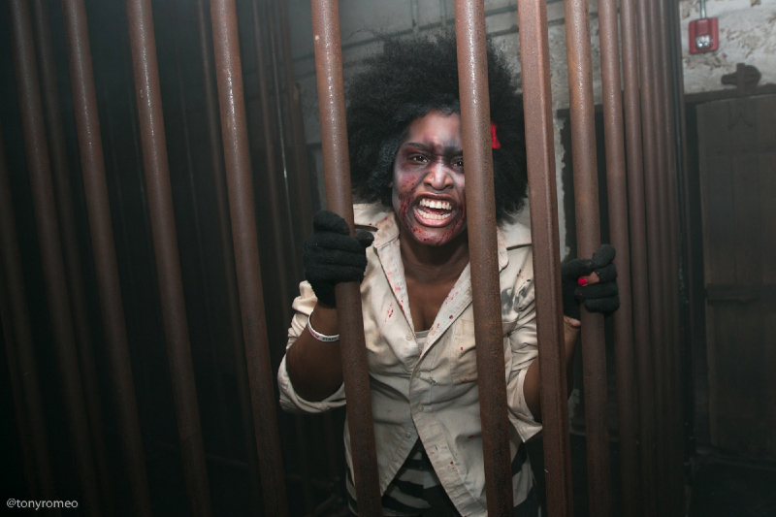
At least part of the reason that it may be complicated is that ...
Reappraisal success mirrored the direction of lab studies, while distraction got worse as intensity increases
These results likely reflect the environmental affordances of that situation; it can be hard to deploy distraction with so many things vying for your attention.
Notes:
… and thus this may represent a common experience of trying to self-regulate in these situations.
These findings suggest that environmental affordances could overshadow the effect of emotion intensity in situations with features that mirror this one, even though the effect size appears so large elsewhere.

Slide 38

Notes:
To explore this further, we examined how people might self-regulate in response to similar content but presented when affordances likely more closely match lab studies.

Slide 39
Study 3
(N = 253)
Conducted in 2023
Participants were recruited via Prolific
Each watched four randomly sorted video clips (120s each) sourced from lesser known horror films.
After each video, negative affective intensity was captured on a sliding 100 point scale.
After all videos were viewed, participants either reported strategy use or forecasting.
Notes:
We recruited 253 subjects online via prolific and mirrored many aspects of the first two studies, but in a more controlled setting.

Slide 40




Study 3
(N = 253)
Conducted in 2023
Participants were recruited via Prolific
Each watched four randomly sorted video clips (120s each) sourced from lesser known horror films.
After each video, negative affective intensity was captured on a sliding 100 point scale.
After all videos were viewed, participants either reported strategy use or forecasting.
High Intensity
Low Intensity
Notes:
The participants each watched four 2 minute video clips sourced from lesser known horror films.
These clips had been selected from a pool of videos which were evaluated by 50 independent raters.
The clips were selected because they were balanced in terms of valence and popularity but were rated as either high or low intensity by the raters.
Subjects were instructed to complete the study in isolation and the task ensured other windows were not visible and the sound was audible throughout the experience.
Emotion regulation was again not explicitly referenced in recruitment for this study to avoid priming subjects.

Slide 41
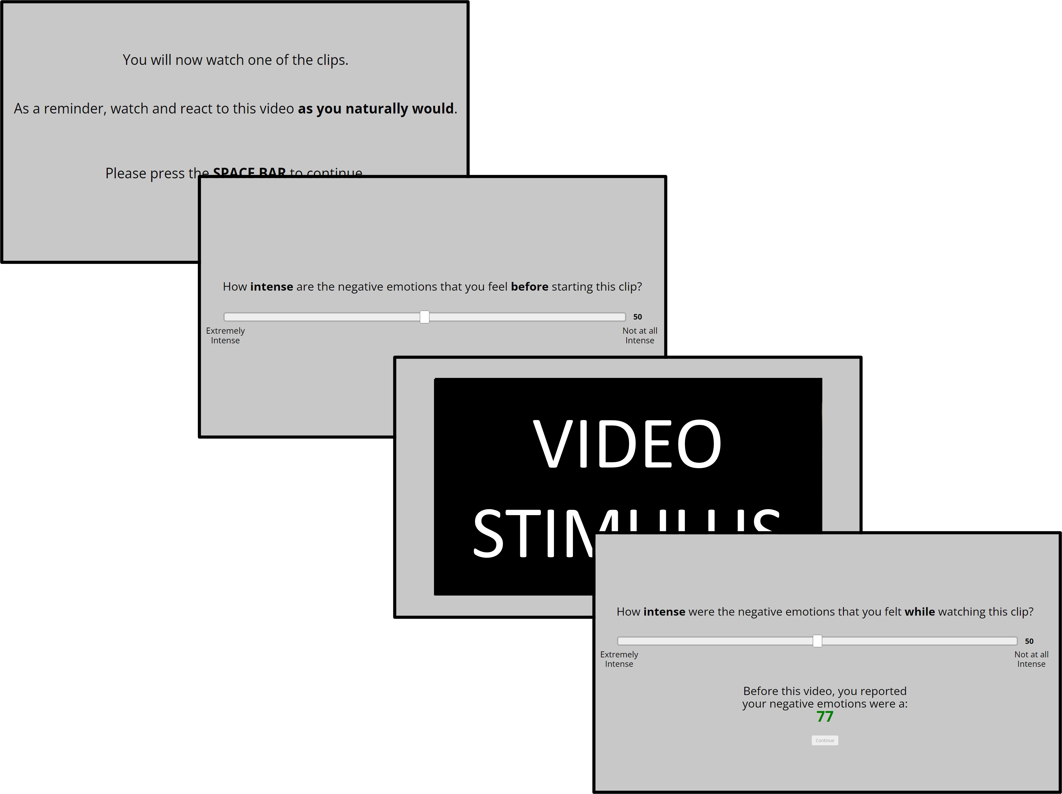
Study 3
(N = 253)
Conducted in 2023
Participants were recruited via Prolific
Each watched four randomly sorted video clips (120s each) sourced from lesser known horror films.
After each video, negative affective intensity was captured on a sliding 100 point scale.
After all videos were viewed, participants either reported strategy use or forecasting.
Notes:
Before and after each video, experienced negative affective intensity was assessed on a sliding 100 point scale.
After all videos were watched, subjects were assigned to either an experience or forecasting condition …

Slide 42
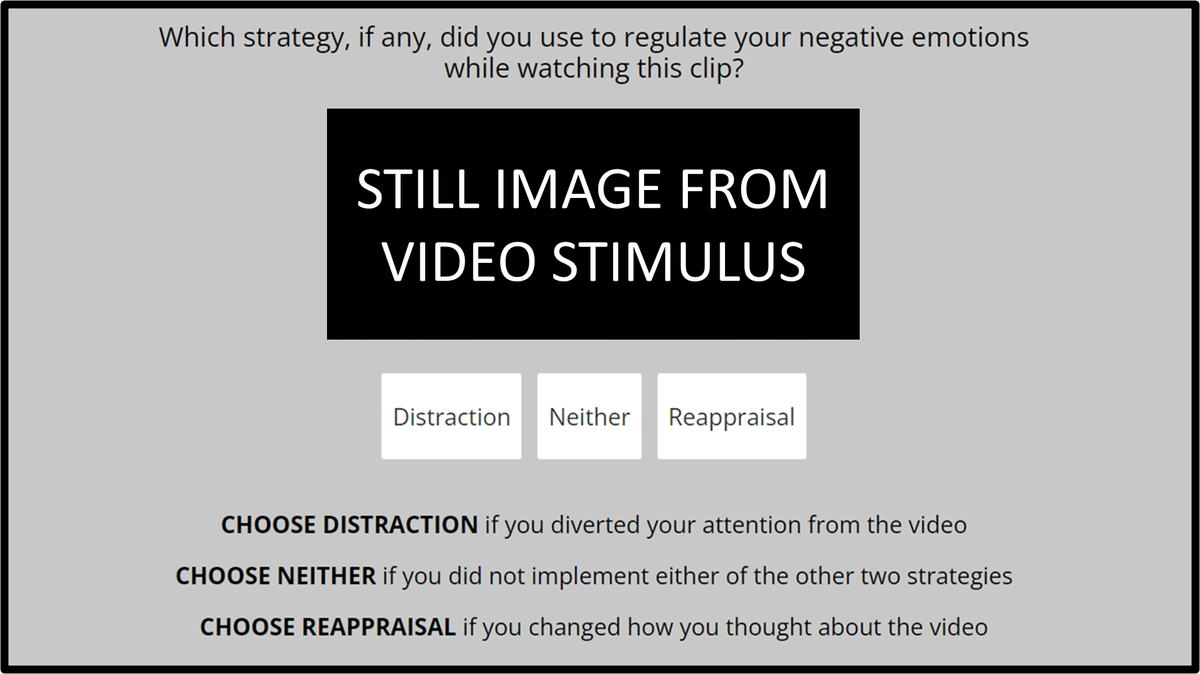
Study 3
(N = 253)
Conducted in 2023
Participants were recruited via Prolific
Each watched four randomly sorted video clips (120s each) sourced from lesser known horror films.
After each video, negative affective intensity was captured on a sliding 100 point scale.
After all videos were viewed, participants either reported strategy use or forecasting.
Notes:
… in which they reported either how they used self-regulation during these videos
or how they predict someone would self-regulate while watching these videos.
Participants were provided definitions of the strategies and completed an exercise to ensure comprehension.
However, participants were given the option to not select either distraction or reappraisal to deviate from the forced-choice, binary nature of previous work.

Slide 43
When comparing usage and forecasting in more controlled circumstances...
At lower intensities, forecasters are less likely to select reappraisal than experiencers were to use reappraisal.
OR = 0.61, 95% CI = [0.39, 0.95], p = 0.029
Mitchell et al., (Under Review)
Notes:
We anticipated that forecasting, relative to actual usage, might look more similar to what we see in lab studies.
The rationale for this supposition is that what stimulus-response paradigms task participants to do could be considered simulating self-regulation usage rather than usage.
Again, we see intensity on the x axis and probability of regulating via distraction on the y axis

Slide 44
When comparing usage and forecasting in more controlled circumstances...
At lower intensities, forecasters are less likely to select reappraisal than experiencers were to use reappraisal.
OR = 0.61, 95% CI = [0.39, 0.95], p = 0.029
Mitchell et al., (Under Review)
Notes:
What we found was that both conditions certainly mirrored previous studies,
with higher intensity experiences being more likely to be regulated via distraction.
However there is once again an interesting distinction between how individuals forecast or predict someone might regulate
and the regulation response individuals actually reported using, which is represented in red.

Slide 45

When comparing usage and forecasting in more controlled circumstances...
At lower intensities, forecasters are less likely to select reappraisal than experiencers were to use reappraisal.
OR = 0.61, 95% CI = [0.39, 0.95], p = 0.029
Mitchell et al., (Under Review)
Notes:
The selection of reappraisal and distraction were evenly distributed among forecasters
which reflects the balanced intensity of our stimuli.
However, experiencers favored reappraisal at the expense of distraction…

Slide 46
When comparing usage and forecasting in more controlled circumstances...
p < 0.01
At lower intensities, forecasters are less likely to select reappraisal than experiencers were to use reappraisal.
OR = 0.61, 95% CI = [0.39, 0.95], p = 0.029
Forecasters used the strategies much more evenly than did experiencers, who relied more on reappraisal.
Mitchell et al., (Under Review)
Notes:
…which we see more clearly here.
A chi-square test found that experiencers’ bias towards reappraisal was significantly different than forecasters’ uses of these two strategies.
In other words: experiencers used distraction less often than forecasters predicted a person would use distraction.

Slide 47
p < 0.001
When comparing usage and forecasting in more controlled circumstances...
At lower intensities, forecasters are less likely to select reappraisal than experiencers were to use reappraisal.
OR = 0.61, 95% CI = [0.39, 0.95], p = 0.029
Forecasters used the strategies much more evenly than did experiencers, who relied more on reappraisal.
Forecasters were much more likely to select regulation over forecasters
Mitchell et al., (Under Review)
Notes:
Additionally, the two conditions differed in how often they regulated at all with forecasters predicting that individuals would self-regulate in response to these stimuli far more often than experiencers actually reported self-regulating.

Slide 48
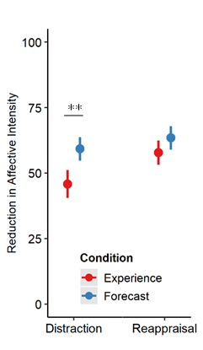
When comparing usage and forecasting in more controlled circumstances...
p = 0.001
Forecasters predicted that distraction would reduce affective intensity when used more than experiencers reported that it actually had.
x̄ _{Experience} = 48.0 | x̄ _{Forecast} = 58.3
95% CI = [-16.62, -4.13]
t(198.2) = -3.28, p = 0.001
Mitchell et al., (Under Review)
Notes:
Lastly, when assessing how much subjects believed their selected strategy reduced or would reduce their negative affective intensity on a sliding 100 point scale,
Predictions and experiences of reappraisal were nearly matching,
but forecasters predicted that distraction would be more effective than experiencers actually reported that it was.
This again illustrates a trend of distraction being less beneficial in these high intensity, high stress situations than what we might actually expect based upon other research.

Slide 49
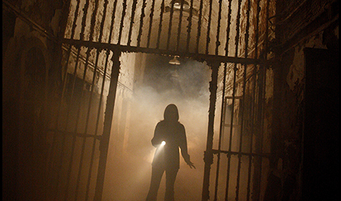
When stressful events are …
Intense
Unexpected
Dynamic
Complex
People do spontaneously self-regulate their emotions
How people self-regulate their emotions may be more influenced by environmental or action affordances than affective intensity, cognitive load, or many other factor commonly examined in the lab
Distraction may be less effective in use than might be expected by choice paradigms or forecasters.
More details on this research can be found in: Mitchell et al. (Under Review). Emotion regulation strategy use and forecasting in response to dynamic, multimodal stimuli. Journal of Experimental Psychology: General
Notes:
There’s obviously still so much work left to do in this space, but these studies at least seem to suggest that
these dynamic, feature-rich study designs provide an opportunity to study self-regulation with less researcher intervention or direction,
that studying self-regulation in these more dynamic designs might yield result patterns that differ quite a bit from the lab,
And that in these high-intensity situations, specifically, distraction might not be as effective as expected.

Slide 50

Self-selection bias
Still an artificial setting that might not generalize to daily life
Very resource intensive
Difficult to execute / coordinate
Difficult to analyze
Notes:
A few key things to keep in mind are that self-selection bias was likely present while recruiting for a study occurring at a haunted house.
Additionally, while this setting may incorporate more dynamic and complex features, it still is a fundamentally artificial environment.

Slide 51

Self-selection bias
Still an artificial setting that might not generalize to daily life
Very resource intensive
Difficult to execute / coordinate
Difficult to analyze
Notes:
Running field studies of this kind can be expensive and requires a lot of coordination and this project was only possible because of NSF funding.
Lastly, with such rich qualitative data, a lot of work is required to clean it and there are many researcher degrees of freedom that can be exercised,
so a detailed preregistration or plan should be used to appropriately justify and document these decisions when possible.

Slide 52
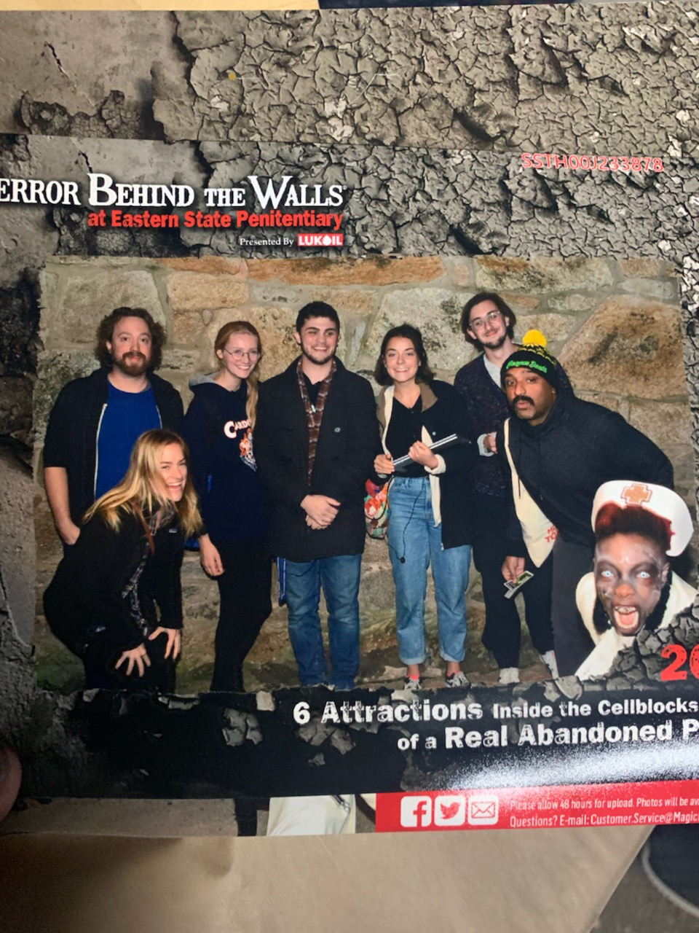



Sincere Appreciation to:
Katelyn Cliver
Emily Cowan
Devlin Eckardt
Matthew Fain
Nicole Gonzalez
Adhya Gowda
Dave Gregory
Chelsea Helion
Kathryn Lockwood
Steven Martinez
Deepu Murty
Ian O’Shea
Sam Reisman
Jane Rothrock
Helen Schmidt
Joanne Stasiak
Angelique Vittone
Check my website for info: wj-mitchell.github.io
Direct questions to: Billy.Mitchell@temple.edu
Made Possible By Union Wages
(If you’re looking for Post-docs
in the Philadelphia area …)
Notes:
In conclusion, sorry once again that I can’t be there with you all,
But thank you all for your attention!
Thank you to the folks who organized this symposium
Thank you to my research team
And if anyone is looking for a post-doc in the Philadelphia area
I’m looking for a place to take my K00 funding.

